Slide 1

Laser Cladding of Pure Copper on Mild Steel Substrate with CO₂ Laser
NAME- KAMBLE SHUBHAM DIPAK
MIS.NO.- 122046006
SY.M-TECH(2022)
GUIDED BY
Prof. M.J.RATHOD
Dept. of Metallurgy and Material Science, College of Engineering, Pune.

Slide 2
Outline of presentation
Motivation
Introduction
Literature review
Summary
Objective
Experimental planning
Results and Discussion
Conclusion
References
Acknowledgement

Slide 3
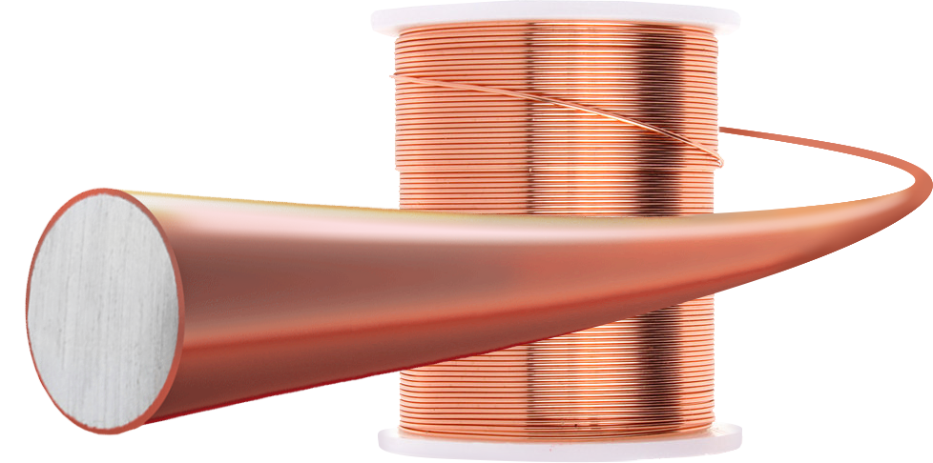

MOTIVATION
In industries such as aerospace, Petro-chemistry, and automotive, many parts of the various machinery in nature are exposed to high temperatures and high pressures, which causes them to age and rust [1]. They are widely used in applications that need room temperature and high-temperature corrosion resistance.
The laser-cladding technique can provide a very promising way to restore the geometry and structural integrity of parts affected by corrosion cracks and wear damage[2].
Pure copper is widely used in heat exchangers, heat pipes, electro circuits, and mechanical parts due to its excellent properties such as high thermal conductivity and high electrical conductivity.

Slide 4
INTRODUCTION
Surface modification method like Laser cladding is used to create a thin layer or coating which improves the surface properties or restores the surface defects by providing a highly resistant coating or layer on the substrate [4].
High power density and high cooling rates make this methods suitable for the wide scope width of materials.
Experimental research and theory show that the effectiveness of laser cladding and surface alloying techniques can be greatly improved by the proper selection of the laser process parameters.
In this work, the pure copper powder was selected as a cladding material on a mild steel substrate, for which the experimentation was performed by varying the process parameters like laser power density, scanning speed, hatch space, scanning strategy, and also a number of layers with an objective to get an optimum process parameters.
The effects of changing the process parameters were compared based on layer hardness, bond shear strength, secondary dendritic arm spacing (SDAS), layer density, and porosity.

Slide 5
LITERATURE SURVEY
Paper Name | Author | Findings
Recent research and development status of laser cladding: A review [1].(2021) | Lida Zhu a,*,1 , Pengsheng Xue a,1 , Qing Lan a , Guiru Meng a , Yuan Ren b , Zhichao Yang a , Peihua Xu a , Zhe Liu c | The existing problems and the development trend of LC is discussed due to its advantages such as lower dilution rate, small heat-affected zone and good metallurgical bonding between coating and substrate.
A Study of Multi-Pass Laser-Cladding 2205 Duplex Stainless Steel Coating: Microstructure, Electrochemical Corrosion Behavior, and Wear-Resistance Properties[2]. (2022) | Feifei Huang 1,2,* , Erju Liu 3,4 , Yi Qin 1 , Qingrui Wang 1 , Ying Jin 1,2,* , Lei Wen 1,2 and Hai Chang 1,2 | Macroscopic observation identified no obvious cracks. large number of equiaxed crystals and a small number of cellular crystals made up the microstructure of the prepared laser-cladding layer, which contributed to its good corrosion resistance.
Recent trends in laser cladding and surface alloying [4].(2021) | Anas Ahmad Siddiqui * , Avanish Kumar Dubey· Jian‑Hong Gong4 · Li‑Na Hu5 | performance of laser cladding and surface alloying techniques can be enhanced significantly by the proper selection of input process parameters. This paper summarizes various research works carried out so far in the area of laser cladding and surface alloying of different materials and their applications.
Copper film formation on metal surfaces with 100W blue direct diode laser system [5]. (2018) | Kohei Asano,1,2 Masahiro Tsukamoto,3 Yoshinori Funada,4 Yu Sakon,5 Nobuyuki Abe,3 Yuji Sato,3 Ritsuko Higashino,3 Masanori Sengoku,6 and Minoru Yoshida6 | copper films on a type 304 stainless steel substrate were achieved using the system at a laser power of 56 W and a scanning speed of 2 mm/s at least.A number of porosities were observed inside the copper films because the laser power is relatively low to the powder mass flow rate. I

Slide 6
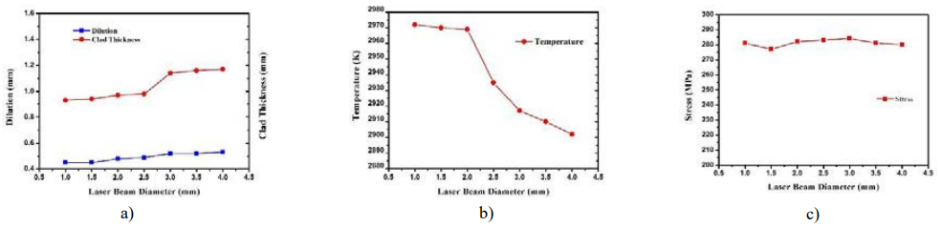
Effect of beam diameter on clad geometry outputs.
It was found that as the laser beam diameter increases the temperature and stress profile decreases.
Because as the beam diameter increases the more surface area gets heated but at a constant input power.
This will increase more mass addition and melting pool but lesser will be the heat input because power will be distributed over the surface .
Fig.1 (a) laser beam diameter effects on dilution & clad height; (b) effects on temperature;(c) effects on stress [21].

Slide 7
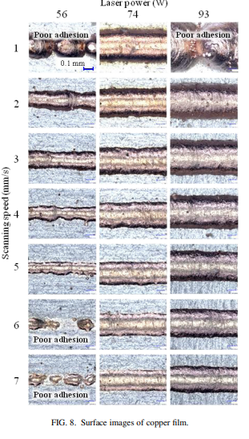
Effect of power and scanning speed on bonding
In the laser cladding process, substrates need to be heated enough to obtain better metallurgical bonding between the substrate and powder material.
The input energy was not enough to heat the substrate when the scanning speed was greater than 5 mm/s.
The slowest scanning speed, poor adhesions were obtained except at the laser power of 74 W.
Fig.2 a) Surface images of copper film. [23].

Slide 8
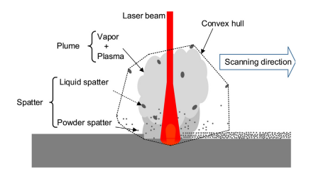
Plasma Effect
During the laser sintering with high energy density, melt temperature increases due to which evaporation of some material from the irradiated area occurs[15].
There evaporated material interacts with the laser beam and ionizes ions, atoms and molecules.
These ionized ions molecule appears in or around the laser beam as plasma.
The plasma produced during the laser sintering is undesired during laser sintering because plasma interacts with laser beam and scatters the laser beam, and reduces the laser beam’s intensity.
Fig.3 Schematic representation of laser processing

Slide 9
SUMMARY
The most important defect observed in the laser cladding is balling phenomenon. This balling phenomenon is mostly attributed to the laser power density. The proper combination of laser power and scanning speed must be maintained to achieve the required power density.
Sintering in an argon atmosphere is preferred over a nitrogen atmosphere because porosity increases due to the absorption of nitrogen during the sintering process.
The laser position parameters, which include beam diameter, hatch space and scanning strategy, play an important role in deciding the density and porosity of the final samples.

Slide 10
OBJECTIVE
Modifying the pre-build selective laser sintering machine (SLS) to perform Laser cladding.
To perform laser cladding of pure copper powder by varying laser power and scanning speed.
To study the effect of laser position on density, porosity and secondary dendrite arm spacing by conducting the microstructural analysis.
To estimate bond shear strength and micro-hardness of the cladded sample.

Slide 11
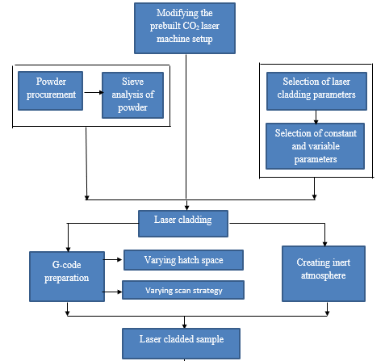
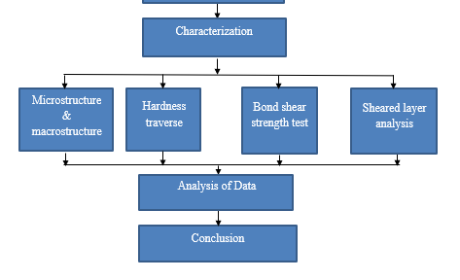
EXPERIMENTAL WORK

Slide 12
Focal length and Beam diameter selection
Beam diameter vs Focal length :-
Focal Length (mm) | Beam Diameter (mm) | Powder Density (W/mm² ) | T_{int (s)}
65.35 | 0.75 | 226.468 | 0.0375
62.52 | 0.7 | 259.976 | 0.0350
59.7 | 0.67 | 283.779 | 0.0335
56.87 | 0.65 | 301.511 | 0.0325
54.04 | 0.59 | 365.953 | 0.0295
51.21 | 0.77 | 214.856 | 0.0385
48.38 | 0.83 | 184.225 | 0.0415
45.55 | 0.88 | 164.499 | 0.0440
42.73 | 0.96 | 138.225 | 0.0480
Fig.4 Variation of beam diameter with focal length

Slide 13
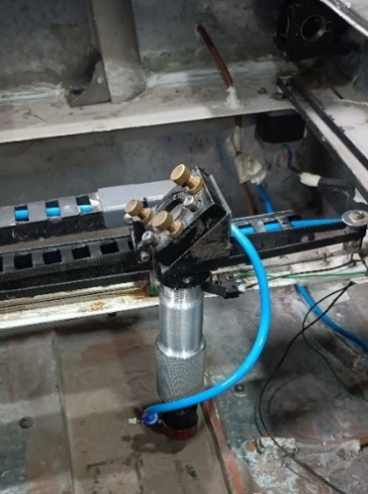
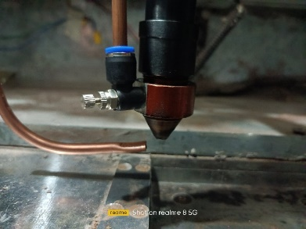
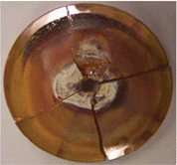
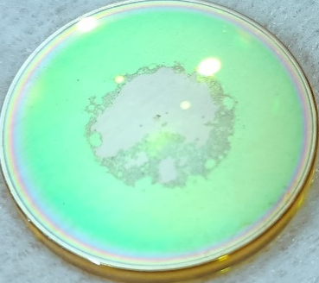
Modifying the CO₂ Laser Machine setup

Slide 14
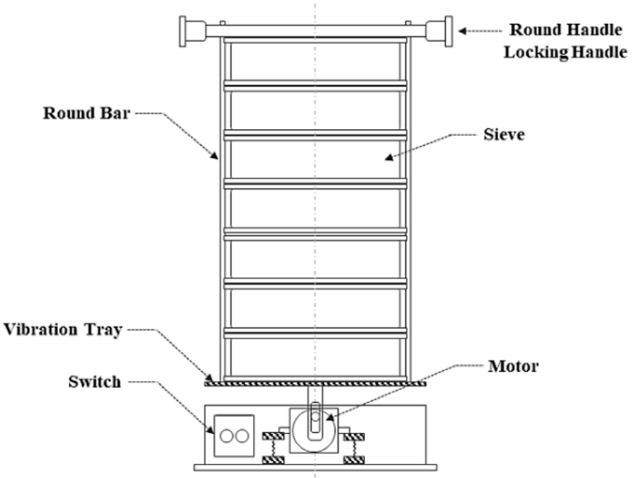
Powder Procurement and characterization
Sieve Analysis :
Sieve analysis of pure copper powder was done on the sieve analyzer machine available in the college to check the particle size distribution. For experimentation 100 gm of powder was used and screened using the sieves of 25 µm, 37 µm, 45 µm, and 53 µm.
Fig.5 Schematic of sieve analyzer.

Slide 15
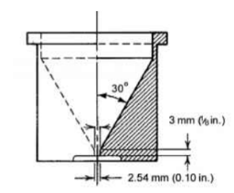
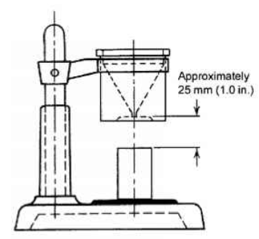
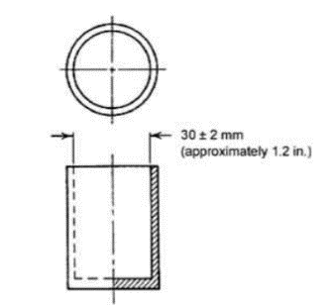
Apparent Density and Flowrate:
a)
b)
c)
Fig.6 a) Hall funnel b) Equipment Assembly c) Density cup [25].
TEST | ASTM standard
Apparent Density | B212
Flowrate | B213

Slide 16
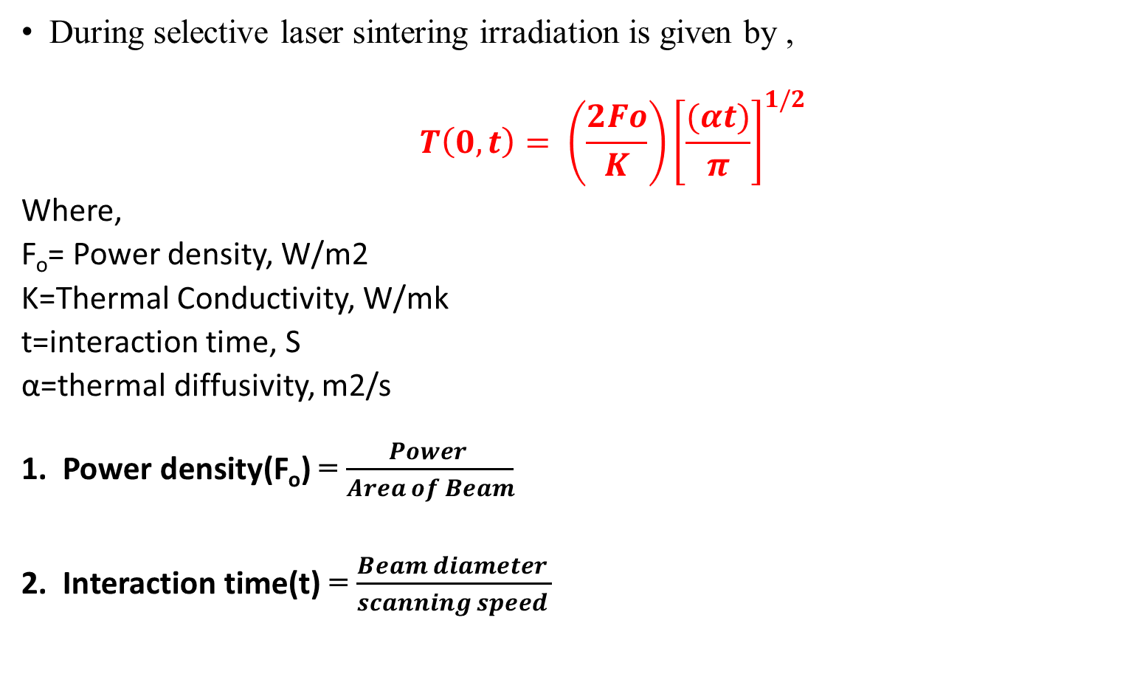
Calculations for surface temperature
During selective laser sintering irradiation is given by ,
$$T\left(0,t\right)= \left(\frac{2Fo}{K}\right){\left[\frac{(αt)}{π}\right]}^{1/2}$$
Where,
F_{o}= Power density, W/m2
K=Thermal Conductivity, W/mk
t=interaction time, S
α=thermal diffusivity, m2/s
Power density(F_{o}) = $\frac{Power }{Area of Beam}$
Interaction time(t) = $\frac{Beam diameter }{scanning speed }$

Slide 17
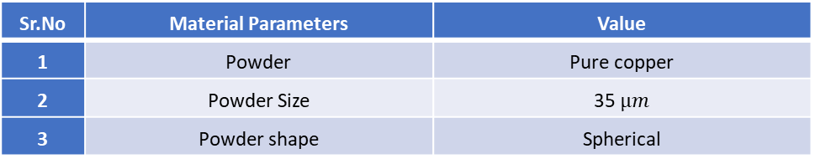
Process parameters :
Sr.No. | Laser Parameters | Value
1 | Laser Mode | Pulsed
2 | Beam Diameter | 0.6 mm
3 | Laser Power | 80W,100W, 140W
Sr.No. | Process Parameters | Value
1 | % overlapping | 0%,17%,60%
2 | Scan strategy | Horizontal, vertical, diagonal
3 | Scan speed | 8 mm/s, 10 mm/s, 13 mm/s
Sr.No | Material Parameters | Value
1 | Powder | Pure copper
2 | Powder Size | 35 $µm$
3 | Powder shape | Spherical
Sr.No | Other Parameters | Value
1 | Argon Gas Flow | Continuous.
2 | Room Temperature | 25⁰ C

Slide 18
For laser beam diameter of 0.6 mm, the surface temperature is calculated.
Parameters assumed for pure copper powder,
Thermal conductivity, K= 50 W/Mk.
Thermal Diffusivity, α = 1.38 × 10-5 m2/s.

Slide 19
Laser cladding Experiments
Sr.No | Laser Power(W) | Scan Speed (mm/s) | No of layers | Hatch Space (mm) | Scan strategy
1 | 80 | 8 | 1 | 0.5 | H
2 | 80 | 8 | 2 | 0.5 | H
3 | 80 | 8 | 3 | 0.5 | H
4 | 80 | 8 | 4 | 0.5 | H
5 | 100 | 8 | 1 | 0.5 | H
6 | 100 | 8 | 2 | 0.5 | H
7 | 100 | 8 | 3 | 0.5 | H
8 | 100 | 8 | 4 | 0.5 | H
9 | 140 | 8 | 1 | 0.5 | H
10 | 140 | 8 | 2 | 0.5 | H
11 | 140 | 8 | 3 | 0.5 | H
12® | 140 | 8 | 4 | 0.5 | H
13 | 140 | 10 | 3 | 0.5 | H
14 | 140 | 13 | 3 | 0.5 | H
15 | 140 | 10 | 3 | 0.25 | H
16 | 140 | 10 | 3 | 0.5 | H
17 | 140 | 10 | 3 | 0.6 | H
18 | 170 | 10 | 3 | 0.5 | H
19 | 170 | 10 | 3 | 0.5 | V
20 | 170 | 10 | 3 | 0.5 | D

Slide 20
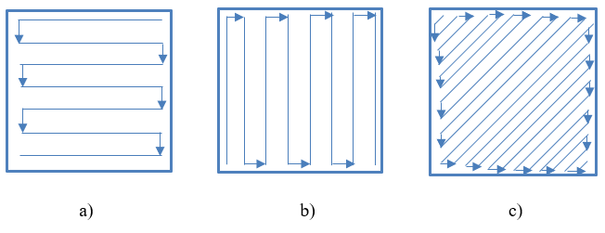
Hatch space
Fig.7 a) Horizontal scan strategy b) Vertical scan strategy c) Diagonal scan strategy

Slide 21
Appearance

Slide 23
Characterization of cladded sample
1. Density and porosity-
Density of the sample was measured using the Archimedes Principle .
2. Hardness testing :
Hardness was measured by a microhardness testing machine on an Vicker’s hardness tester.
An indentation is made on the specimen by a diamond indenter through the application of a 100 gf load and a dwell time of 10 seconds.
3. Microstructure:
The square samples were observed under an optical microscope at 100X 200X, 500X, 1000X and 2000X magnifications.
Images were taken on the image analyzer to find the secondary dendritic arm spacing (SDAS) at 500X.

Slide 24
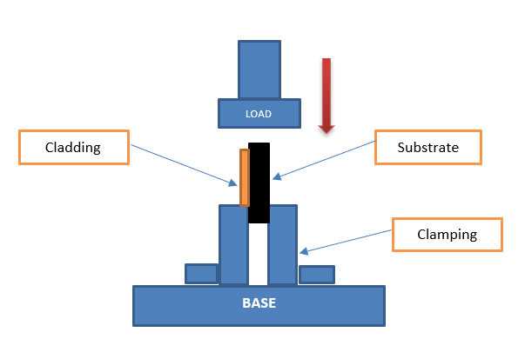
Bond shear strength test:
Fig.8 Block diagram for Bond shear strength test.

Slide 25
Results and Discussion
Apparent Density and Flowrate:
Both the tests were performed 10 times and the average results were considered.
Apparent density = 2.9 g/cc
Flowrate = 35 sec/50gm

Slide 26
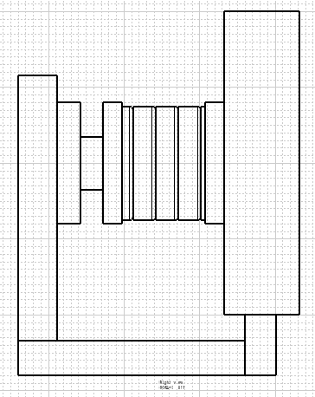
Sieve-Analysis:-
A mechanical sieve shaker having rotary and tapping action
was used for the sieve analysis of 100gm of pure copper powder.
53µm
45µm
37µm
25µm
SIEVE SIZE (µm) | Weight (gm)
25 | 55.61
37 | 30.86
45 | 4.94
53 | 3.57
 | Total = 94.98

Slide 27
Particle size distribution of powder :
Avg. Particle Size = 35 µm
a)
b)
Fig.9 a) Particle size distribution of pure copper powder b) SEM image of copper at 1000X

Slide 28
Density and Porosity :
The density of sintered sample depends on laser power density and interaction time.
The difference in density of cladding is due to the presence of porosities in the sample.
The presence of porosity can be attributed to two reasons ie.
Improper melting or heating of the substrate and clad layer - oxidation of the powder which produces spherical holes.
Delay in melt pool formation of a substrate- The energy incident on the surface normal to the incident beam is insufficient to re-melt both the previous track and the substrate.
When the scanning speed increases, due to lower interaction time and improper melting, a melt pool will not form causing the porosity to increase.
For lower laser power also low melting will happen which results in poor adhesion and porosity.

Slide 29
Fig.10 Power vs Porosity
Fig.11 Power vs Relative Density
Fig.12 Speed vs Porosity
Fig.13 Speed vs Relative Density

Slide 30
Fig.14 Hatch space vs Porosity
Fig.15 Hatch space vs Relative Density
Fig.16 Scan strategy vs Porosity
Fig.17 Scan strategy vs Relative Density

Slide 31
Microhardness Test:-
Effect of power and number of layer variations on the microhardness :
The highest microhardness was found to be near the substrate which can be attributed to the heat-affected zone (HAZ).
The least microhardness was found at the interaction of the substrate and copper layer due to improper bonding.
It was observed that as the number of layers increases the hardness goes on decreasing which can be occurred due to the grain growth of the previously deposited layer.

Slide 32
Microhardness Test:-
Effect of power and number of layer variations on the microhardness :
Fig.18 1L sample graph
Fig.19 2L sample graph
Fig.21 4L sample graph
Fig.20 3L sample graph

Slide 33
Effect of scanning speed on microhardness :
Samples fabricated with a laser scanning speed of 8mm/ sec has the lowest hardness value, while sample fabricated with 13 mm/sec scanning speed has the highest hardness value.
This increase in the hardness can be attributed to the grain refinement because as the scanning speed increases interaction time of the beam with the surface decreases avoiding grain growth.
Effect of hatch space on microhardness :
With increasing the hatch space hardness showed a decreasing trend as the overlapping of the layer decreases as hatch space increases.
Effect of Scan strategy on microhardness:
From the results, it was found hardness for the horizontal scan strategy showed good results compared to vertical and diagonal scan strategies.
SDAS results showed a lower value for the horizontal scan strategy.
So it can be concluded that the horizontal scan strategy has faster cooling rates which resulted in finer grains and good microhardness.

Slide 34
Effect of scanning speed on microhardness :
Effect of hatch space on microhardness :
Effect of hatch space on microhardness :

Slide 35
Bond shear strength test:
Effect of laser power and the number of layers on bond shear strength
The strength showed an increasing trend with respect to laser power. But as the number of layers increased to 4 there was a slight drop in the strength.
This can be attributed to the coarser grain structure formation at the bottom layers due to more heat interaction.
Fig.22 Laser power vs No. of Layers vs Max. Load

Slide 36
Effect of scan speed on bond shear strength :
From the results mentioned in the fig below, it was observed that the maximum load taken before the shearing of the sample is 14.6 KN for the sample fabricated with 13 mm/sec scan speed, whereas for the sample produced with 8 mm/sec scan maximum load was 11.4 KN.
For higher scan speeds, lesser interaction time and fine grain structure resulted in the higher shear strength.
Fig.23 Scan speed vs Max load variation

Slide 37
Effect of hatch spacing on bond shear strength :
For the samples fabricated with 0.25 mm scan spacing, there is a 0.60 % overlap between the subsequent scans, which resulted in more heat interaction, more cooling time and coarse grain structure.
Samples fabricated with 0.25 mm hatch space have a maximum load of 11.3 KN whereas, for the 0.6mm hatch space, the maximum load was 25.5 KN due to 0% overlapping between subsequent layers.
Fig.24 Hatch space vs Max load

Slide 38
Effect of scan strategies on bond shear strength :
As observed in Fig. below the maximum load taken by the sample was fabricated with a horizontal scan strategy.
This can be attributed to the rapid cooling rates and finer grains as also mentioned in the results of secondary dendritic arm spacing.
Fig.25 Scan strategy vs Maximum load

Slide 39
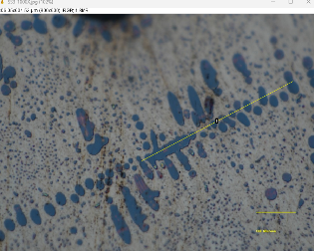
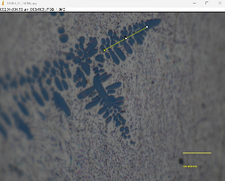
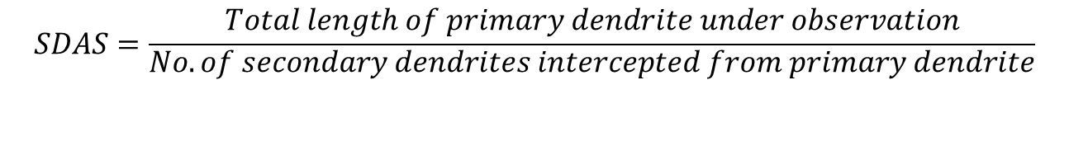
Secondary dendritic arm spacing (SDAS)
$$SDAS=\frac{Total length of primary dendrite under observation}{\begin{aligned}No. of secondary dendrites intercepted from primary dendrite \\ \end{aligned}}$$
Fig. Dendritic microstructure formation .

Slide 40
Secondary dendritic arm spacing (SDAS):
This formed dendritic micro-structure confirms the liquid phase sintering mechanism. The melting point of steel is about 1520 °C whereas for copper it is 1083 °C. During cladding, the temperature increased above the melting point of both metals.
Dendrites are formed due to the solidification that takes place over the temperature range.
Dendrite arm spacing decreases with an increase in the cooling rate.
As the cooling rate decreases, more time is available for the diffusion of atoms of it to diffuse to a larger distance so the dendrite arm spacing increases.

Slide 41
Fig.26 Power vs layers vs SDAS
Fig.27 Scan speed vs SDAS
Fig.28 Hatch space vs SDAS
Fig.29 Scan strategy vs SDAS

Slide 42
Conclusion
The modification of the copper pipe slit, fastened to the nozzle so that argon gets introduced just below the nozzle tip, completely solved the problem of lens break.
Increasing the power from 80 W to 140 W, increased the maximum load from 6.2 KN to 21.3 KN during the bond shear strength test.
Increase in the secondary dendritic arm spacing was observed due to reduced cooling rate. It was increased when scan speed, hatch space were decreased and power was increased.
The horizontal scan strategy has better results compared to the vertical and diagonal scan strategies. SDAS of 8.90 µm,10.23 µm, and 43.40 µm was observed for horizontal, vertical, and diagonal respectively. So, the presence of finer grains and higher cooling rates resulted in better properties of samples made with the horizontal scan strategy.
So higher power of 140 w, higher scan speed of 13 mm/sec, hatch space with lesser overlapping that is 0.5mm and horizontal scan strategy concluded as optimum parameters.

Slide 43
REFERENCES
Lida Zhu a,*,1 , Pengsheng Xue a,1 , Qing Lan a , Guiru Meng a , Yuan Ren b , Zhichao Yang a , Peihua Xu a , Zhe Liu c - Recent research and development status of laser cladding: A review.(2021)
Feifei Huang 1,2,* , Erju Liu 3,4 , Yi Qin 1 , Qingrui Wang 1 , Ying Jin 1,2,* , Lei Wen 1,2 and Hai Chang 1,2- A Study of Multi-Pass Laser-Cladding 2205 Duplex Stainless Steel Coating: Microstructure, Electrochemical Corrosion Behavior, and Wear-Resistance Properties(2022)
Feifei Huang 1,2,* , Erju Liu 3,4 , Yi Qin 1 , Qingrui Wang 1 , Ying Jin 1,2,* , Lei Wen 1,2 and Hai Chang 1,2- A Study of Multi-Pass Laser-Cladding 2205 Duplex Stainless Steel Coating: Microstructure, Electrochemical Corrosion Behavior, and Wear-Resistance Properties(2022)
Anas Ahmad Siddiqui * , Avanish Kumar Dubey- Recent trends in laser cladding and surface alloying (2021)….
Kohei Asano,1,2 Masahiro Tsukamoto,3 Yoshinori Funada,4 Yu Sakon,5 Nobuyuki Abe,3 Yuji Sato,3 Ritsuko Higashino,3 Masanori Sengoku,6 and Minoru Yoshida6 - Copper film formation on metal surfaces with 100 W blue direct diode laser system.
Ravi Parekha,b,*, Ramesh Kumar Buddua , R.I. Patelb- Multiphysics simulation of laser cladding process to study the effect of process parameters on clad geometry.
R. M. Mahamood1,2,3 and E. T. Akinlabi1 Effect Of The Scanning Speed Of Treatment On The Microstructure, Microhardness, Wear, And Corrosion Behavior Of Laser Metal-Deposited Ti–6al–4v/Tic Composite.

Slide 44
REFERENCES
K. Shahzad et al., Additive manufacturing of alumina parts by indirect selective laser sintering and post processing, Journal of Materials Processing Technology 213 (2013) 1484– 1494.
William M. Steen · Jyotirmoy Mazumder- Laser Material Processing (4th Edition)

Slide 45
ACKNOWLEDGEMENTS
I would like to express my gratitude and appreciation to all those who gave me an opportunity to complete this project special thanks to my project guide Prof. M. J. Rathod for giving me the opportunity to work on CO₂ laser machine-related project where it imparted knowledge of the role of metallurgy in 3D printing and surface engineering industry. His stimulating suggestions and encouragement helped me in repairing the CO₂ laser machine, also his continuous guidance made my project from scratch to useful output.
I would also like to acknowledge to our Head of Department Dr. S.P. Butee for his consistent support during entire M-Tech project.
I would also like to thank Dr.A.E. Muley and her Ph.D. scholar Mr. Sandesh Patil for allowing and providing the necessary guidelines for the CO₂ laser machine working setup of the Production Department, College of Engineering, Pune.
My sincere thanks to my parents for their consistent support and faith in me.
Last but not least, my sincere thanks to all teaching and non-teaching staff, my senior Ph.D. pursuing staff and my colleagues of the Metallurgy and Materials Science department, College of Engineering Pune.

Slide 46
THANK YOU

Slide 47
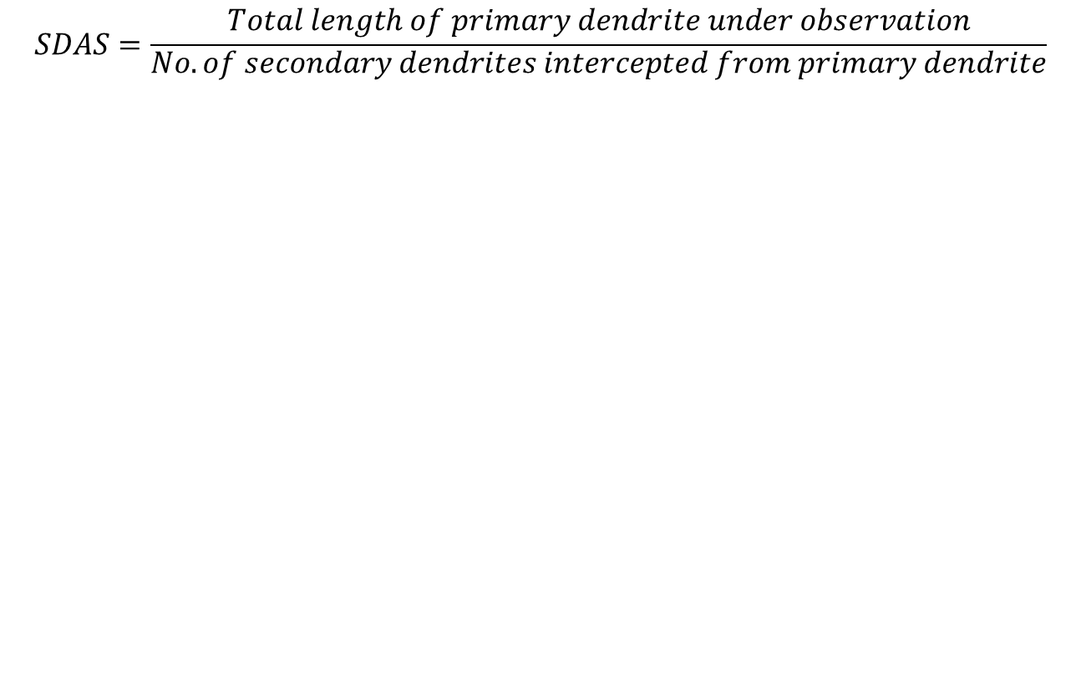
Secondary dendritic arm spacing (SDAS)
$$SDAS=\frac{Total length of primary dendrite under observation}{\begin{aligned}No. of secondary dendrites intercepted from primary dendrite \\ \end{aligned}}$$

